Slide 1
Onionion.com
Alisha Mirza​
Enrollment No. BDA22
Semester 1st
ICT Ganpat University

Slide 2
Introduction
Problem ID: PID005
Challenge Title : Efficient Onion Storage
Expected Outcomes : Onion can be stored for longer period.

Slide 4
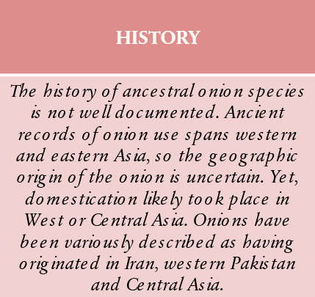
Home Page

Slide 5
TYPES OF ONIONS
”
Yellow Onions : These are sweeter and are the onions of choice for everyday use in European cuisine, with many cultivars bred specifically to demonstrate this sweetness
Red Onions : These are known for their sharp pungent flavour and are the onions of choice for everyday use in Asian cuisine.
White Onions : These are traditional in classic Mexican cuisine,and are milder in flavor

Slide 6
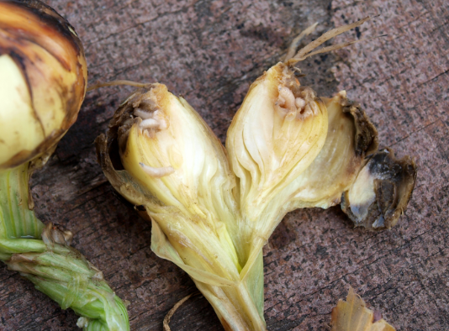
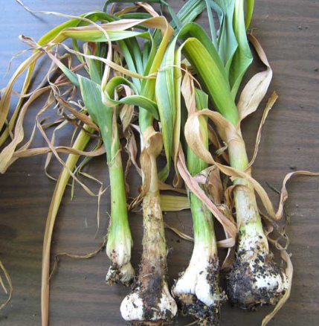
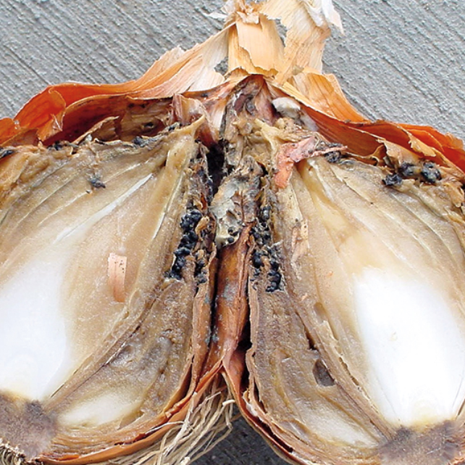
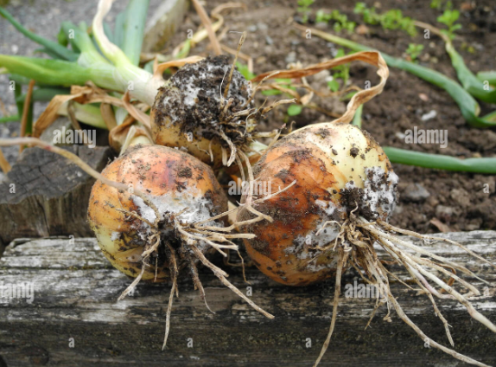
Pest And Diseases
The Onion Fly
The onion eelworm
White rot of onions
​
Neck rot
First disease
Second diseases
Third diseases
Fourth diseases

Slide 7
Storage
In Home Cooking onions and sweet onions are better stored at room temperature, optimally in a single layer, in large mesh bags in a dry, cool, dark, well-ventilated location. In this environment, cooking onions have a shelf life of three to four weeks and sweet onions one to two weeks. Cooking onions will absorb odours from apples and pears. Also, they draw moisture from vegetables with which they are stored which may cause them to decay.
Storage Process
How are onions stored?
The processes required to store onions properly.
Once they are stored, onions undergo the following processes:
The drying process
The processes of raising or lowering their temperature
Conservation or storage proper

Slide 8
THANK YOU

